Slide 1


Instance-Based Learning: k-Nearest Neighbours
11
PART III · SUPERVISED LEARNING ALGORITHMS
CHAPTER 11 · WEEK 10
Machine Learning — From Hypotheses to Decisions
LECTURER
Dr. Mustafa Hameed
THE ISLAMIA UNIVERSITY OF BAHAWALPUR
Bahawalpur, Pakistan
Department of Information Technology · BSIT · Fall 2026
Notes:
Chapter 11: Instance-Based Learning: k-Nearest Neighbours. Part 3 — Supervised Learning Algorithms. Week 10: Nearest neighbours; support vector machines. Handout pages 85–90.

Slide 2

Where this chapter sits
THE COURSE
PART I
PART II
PART III
PART IV
PART V
PART VI
1
2
3
4
5
6
7
8
9
10
11
12
13
14
15
16
17
18
19
20
21
22
Instance-Based Learning: k-Nearest Neighbours
BUILDS ON
USED LATER IN
Ch 2 Mathematics for Machine Learning
Ch 12 Support Vector Machines
Ch 3 The Machine Learning Workflow and Toolkit
Ch 15 Clustering
Ch 7 Overfitting, Bias–Variance and Regularisation
Ch 16 Dimensionality Reduction and Self-Organizing Maps
Machine Learning · Chapter 11 · Instance-Based Learning: k-Nearest Neighbours
Handout p. 85 2
Notes:
Place the chapter. Before you start: Chapter 2 (Euclidean distance), Chapter 3 (standardisation) and Chapter 7 (bias, variance, cross-validation). The HEC outline lists k-NN under unsupervised learning; it is supervised — it needs labels to vote with — and is taught here with the other classifiers.

Slide 3

What you will be able to do
LEARNING OUTCOMES
By the end of this chapter you will be able to:
1
Distinguish lazy (instance-based) from eager learning.
2
Classify an example with k-nearest neighbours by hand, with and without distance weighting.
3
Choose a distance measure, and explain why features must be scaled first.
4
Select k by cross-validation, relating small and large k to variance and bias.
5
Explain the curse of dimensionality and the computational cost of nearest-neighbour search.
Machine Learning · Chapter 11 · Instance-Based Learning: k-Nearest Neighbours
Handout p. 85 3
Notes:
Read these out: they are the chapter's contract with the room. Each click adds one.

Slide 4

Vocabulary for this chapter
KEY TERMS
instance-based learning
lazy vs. eager learning
k-nearest neighbours
majority vote
distance-weighted vote
Euclidean, Manhattan, Minkowski and Hamming distance
Voronoi cell
k-NN regression
locally weighted regression
curse of dimensionality
KD-tree
case-based reasoning
Each term is defined where it first matters — not here.
Machine Learning · Chapter 11 · Instance-Based Learning: k-Nearest Neighbours
Handout p. 85 4
Notes:
Do not define these now; they arrive one at a time. This slide is for the students' notes. Terms: instance-based learning; lazy vs. eager learning; k-nearest neighbours; majority vote; distance-weighted vote; Euclidean, Manhattan, Minkowski and Hamming distance; Voronoi cell; k-NN regression; locally weighted regression; curse of dimensionality; KD-tree; case-based reasoning.

Slide 5
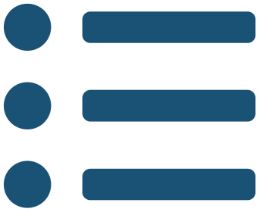
In this chapter
IN THIS CHAPTER
11.1
Learning by Remembering
p. 85 ›
11.2
The k-Nearest Neighbour Algorithm
p. 85 ›
11.3
Distance and Scale
p. 86 ›
11.4
Choosing k
p. 87 ›
11.5
Beyond Classification
p. 87 ›
11.6
The Curse of Dimensionality
p. 88 ›
11.7
The Cost of Being Lazy
p. 88 ›
Machine Learning · Chapter 11 · Instance-Based Learning: k-Nearest Neighbours
Handout pp. 85–90 5
Notes:
The route through the chapter. Each row is a link: click it to jump to that section in the slide show.

Slide 6
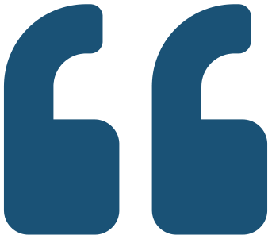
Learning by Remembering
KEY IDEA
Every learner so far has been eager: it studies the training data once, builds an explicit model — a line, a tree, a table of probabilities — and then discards the data. Instance-based learning is lazy. It stores the training examples and does nothing more until asked to classify a new one; only then does it look for the stored examples most similar to the query and let them decide.
The idea is old and intuitive: to predict whether a student will pass, find the students most like them and see how they did. Its strengths follow directly. There is no training time, the model can be as complex as the data (the decision boundary follows whatever shape the examples trace), and new examples are added by simply storing them. Its weaknesses follow too: every prediction requires searching the stored data, and “most similar” is only as good as the distance measure.
Machine Learning · Chapter 11 · Instance-Based Learning: k-Nearest Neighbours
§11.1 · Handout p. 85 6
Notes:
Say this in your own words first; the slide is the handout's wording.

Slide 7
The k-Nearest Neighbour Algorithm
SECTION 2 OF 7
11.2
11.1 Learning by Remembering
11.2 The k-Nearest Neighbour Algorithm
11.3 Distance and Scale
11.4 Choosing k
11.5 Beyond Classification
11.6 The Curse of Dimensionality
11.7 The Cost of Being Lazy
Machine Learning · Chapter 11
Handout §11.2 7
Notes:
Pause. Name the question this section answers.

Slide 8

k-Nearest Neighbours
DEFINITION
To classify a query x_{q}:
1. compute its distance to every stored training example;
2. take the k examples with the smallest distances;
3. predict the most common class among them (for regression, the mean of their target values).
Its inductive bias is smoothness: the classification of an instance is most similar to the classifications of instances nearby in the feature space.
Machine Learning · Chapter 11 · Instance-Based Learning: k-Nearest Neighbours
§11.2 · Handout p. 85 8
Notes:
Read the box aloud, then ask for an example from the room before moving on.

Slide 9
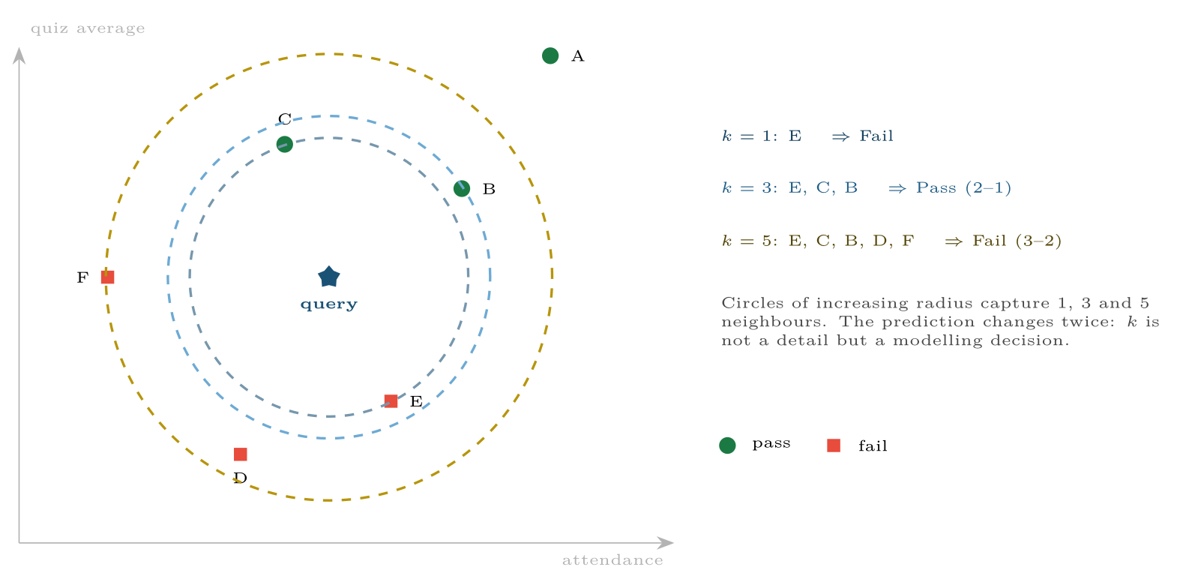
Six students and one query
FIGURE 11.1
Which class the query receives depends on how many neighbours are asked. (Axes scaled so that 10 marks = one unit.)
Machine Learning · Chapter 11 · Instance-Based Learning: k-Nearest Neighbours
§11.2 · Handout p. 85 9
Notes:
Figure 11.1 (handout p. 86): Six students and one query. Which class the query receives depends on how many neighbours are asked. (Axes scaled so that 10 marks = one unit.)

Slide 10

Three Values of k, Three Answers
WORKED EXAMPLE
Six students, with attendance and quiz average in percent: A (90, 85) Pass; B (80, 70) Pass; C (60, 75) Pass; D (55, 40) Fail; E (72, 46) Fail; F (40, 60) Fail. Classify the query Q (65, 60). Both features are on the same 0–100 scale, so no rescaling is needed.
Distances from Q, sorted:
• E: √(7² + 14²) = √(245) = 15.65 (Fail)
• C: √(5² + 15²) = √(250) = 15.81 (Pass)
• B: √(15² + 10²) = √(325) = 18.03 (Pass)
• D: √(10² + 20²) = √(500) = 22.36 (Fail)
• F: √(25² + 0²) = 25.00 (Fail)
• A: √(25² + 25²) = √(1250) = 35.36 (Pass)
Machine Learning · Chapter 11 · Instance-Based Learning: k-Nearest Neighbours
§11.2 · Handout p. 85 10
Notes:
Each click adds one step of the working. Ask for the next number before you reveal it.

Slide 11
Three Values of k, Three Answers (continued)
WORKED EXAMPLE
k = 1: E ⇒ Fail. k = 3: E, C, B ⇒ Pass, 2 to 1. k = 5: add D, F ⇒ Fail, 3 to 2.
Distance-weighted, k = 5. Weight each vote by 1/d²: Fail = 1/245 + 1/500 + 1/625 = 0.00768; Pass = 1/250 + 1/325 = 0.00708. Fail, narrowly — E, the nearest neighbour, counts for more than F, the farthest.
Machine Learning · Chapter 11 · Instance-Based Learning: k-Nearest Neighbours
§11.2 · Handout p. 85 11
Notes:
Each click adds one step of the working. Ask for the next number before you reveal it.

Slide 12
Distance and Scale
SECTION 3 OF 7
11.3
11.1 Learning by Remembering
11.2 The k-Nearest Neighbour Algorithm
11.3 Distance and Scale
11.4 Choosing k
11.5 Beyond Classification
11.6 The Curse of Dimensionality
11.7 The Cost of Being Lazy
Machine Learning · Chapter 11
Handout §11.3 12
Notes:
Pause. Name the question this section answers.

Slide 13
Distance Measures
DEFINITION
For vectors x and z with d features:
•
•
•
• Hamming: the number of attributes that differ — for categorical data.
• Cosine distance: 1 − cosθ — for text and other data where direction matters more than length (Chapter 2).
Machine Learning · Chapter 11 · Instance-Based Learning: k-Nearest Neighbours
§11.3 · Handout p. 86 13
Notes:
Read the box aloud, then ask for an example from the room before moving on.

Slide 14

Always Scale Before Measuring Distance
WATCH OUT
Add “logins per week” (0–40) to the worked example, and a difference of 20 logins outweighs every difference in marks. The distance is decided by whichever feature has the largest units. Standardise first (Chapter 3). On the breast cancer data of this chapter’s lab, 5-NN makes 7.0% cross-validated errors on raw features and 3.3% after standardising — the same algorithm, half the error.
Machine Learning · Chapter 11 · Instance-Based Learning: k-Nearest Neighbours
§11.3 · Handout p. 86 14
Notes:
Read the box aloud, then ask for an example from the room before moving on.

Slide 15
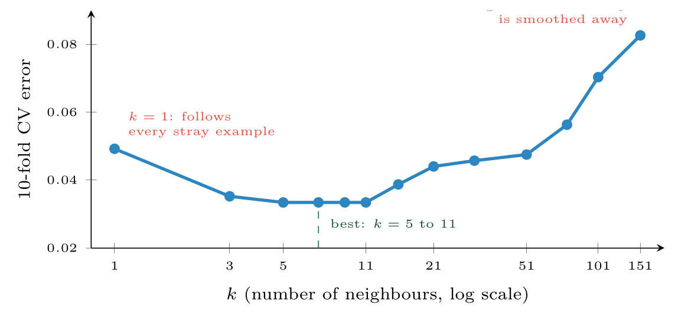
Cross-validated error of k-NN on the (standardised) breast cancer data
FIGURE 11.2
Small k has high variance, large k high bias; the familiar U-shape.
Machine Learning · Chapter 11 · Instance-Based Learning: k-Nearest Neighbours
§11.4 · Handout p. 87 15
Notes:
A second, subtler problem is irrelevant features. k-NN uses every feature equally, so twenty features of which two matter give a distance that is mostly noise. Decision trees choose which attributes to test; k-NN cannot, unless the features are selected or weighted beforehand — Mitchell’s suggestion is to stretch each axis by a weight chosen by cross-validation. The decision boundary of 1-NN runs between every pair of differently labelled neighbours: each training example owns a Voronoi cell, the region of space closer to it than to any other example, and the boundary is made of cell edges. It follows every stray example — low bias, high variance. Increasing k averages over more neighbours and smooths the boundary; with k = n it predicts the majority class everywhere — high bias, zero variance. k is the regularisation knob of Chapter 7, and it is chosen the same way.
Figure 11.2 (handout p. 87): Cross-validated error of k-NN on the (standardised) breast cancer data. Small k has high variance, large k high bias; the familiar U-shape.

Slide 16
Beyond Classification
KEY IDEA
k-NN regression predicts the mean (or distance-weighted mean) of the neighbours’ target values. Locally weighted regression, in Mitchell’s treatment, goes further: for each query it fits a small linear model to the nearby examples only, weighted by their distance, and uses that model’s prediction. The global function is approximated by a patchwork of local ones — a model that could never be written down in advance.
Case-based reasoning applies the same lazy idea to rich symbolic descriptions: a help-desk system that retrieves the most similar past incident and adapts its solution. Similarity there is measured by matching structure, not by a formula.
Machine Learning · Chapter 11 · Instance-Based Learning: k-Nearest Neighbours
§11.5 · Handout p. 87 16
Notes:
Say this in your own words first; the slide is the handout's wording.

Slide 17
The Curse of Dimensionality
SECTION 6 OF 7
11.6
11.1 Learning by Remembering
11.2 The k-Nearest Neighbour Algorithm
11.3 Distance and Scale
11.4 Choosing k
11.5 Beyond Classification
11.6 The Curse of Dimensionality
11.7 The Cost of Being Lazy
Machine Learning · Chapter 11
Handout §11.6 17
Notes:
Pause. Name the question this section answers.

Slide 18
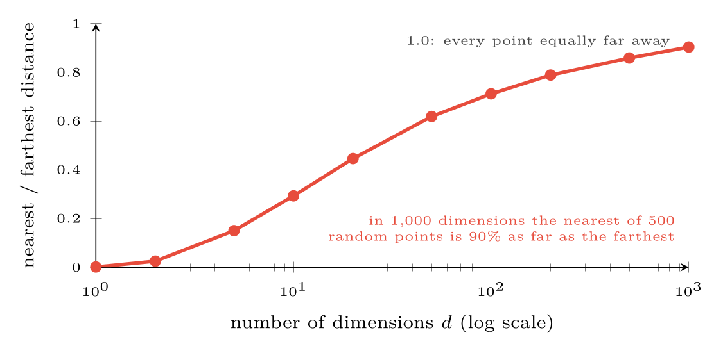
The curse of dimensionality
FIGURE 11.3
For 500 uniformly random points, the ratio of the nearest to the farthest distance from a query rises towards 1 as dimensions are added: “nearest” stops meaning anything.
Machine Learning · Chapter 11 · Instance-Based Learning: k-Nearest Neighbours
§11.6 · Handout p. 88 18
Notes:
Two practical rules: for two classes use an odd k, so votes cannot tie; and treat √n as a rough upper starting point, then let cross-validation decide. Nearest-neighbour methods rest on the idea that the nearest examples are meaningfully closer than the rest. In high dimensions that stops being true.
Figure 11.3 (handout p. 88): The curse of dimensionality. For 500 uniformly random points, the ratio of the nearest to the farthest distance from a query rises towards 1 as dimensions are added: “nearest” stops meaning anything.

Slide 19

Why Distances Concentrate
CONCEPT
Each extra dimension adds another independent term to the sum under the square root. With many terms, the sums for different pairs of points all come out close to their average — the same reason an average of many coin tosses is close to one half. So every point ends up at nearly the same distance from every other, and the nearest neighbour is barely nearer than a random one. The remedies are fewer dimensions (feature selection, or PCA in Chapter 16) or a learned notion of similarity.
Machine Learning · Chapter 11 · Instance-Based Learning: k-Nearest Neighbours
§11.6 · Handout p. 88 19
Notes:
Read the box aloud, then ask for an example from the room before moving on.

Slide 20

Common pitfalls
COMMON PITFALLS
✕
Forgetting to scale. The feature with the biggest units decides everything.
✕
Using k = 1 on noisy data. Every mislabelled example claims a region of its own.
✕
Using an even k for two classes. Ties must then be broken arbitrarily.
✕
Keeping irrelevant features. They add noise to every distance; select or weight features first.
✕
Ignoring prediction cost. Fine for thousands of examples, slow for millions without an index.
Machine Learning · Chapter 11 · Instance-Based Learning: k-Nearest Neighbours
§11.7 · Handout p. 88 20
Notes:
For each pitfall, ask who has seen it happen. One real story beats five bullets.

Slide 21





Four lenses: Nearest Neighbours
FOUR LENSES
LEARNING ANALYTICS
PROJECT MANAGEMENT
“Students like you” is k-NN, and it is how many course recommendation systems work: find the ten most similar past students and suggest the electives they did well in.
Analogy-based effort estimation is k-NN regression: find the three completed projects most similar to the new one and average their effort.
INTERNET OF THINGS
CYBERSECURITY
A machine’s current vibration signature is compared with a library of signatures recorded before known failures; the nearest match names the likely fault.
Anomaly detection by distance: a login whose nearest neighbours among the account’s own history are all far away is unusual.
Machine Learning · Chapter 11 · Instance-Based Learning: k-Nearest Neighbours
Handout p. 90 21
Notes:
The same method, four domains. Each of the next four slides opens one lens in full.

Slide 22

Learning Analytics: Nearest Neighbours
FOUR LENSES
LEARNING ANALYTICS
Project Management
“Students like you” is k-NN, and it is how many course recommendation systems work: find the ten most similar past students and suggest the electives they did well in. The explanation is built in — here are the students you resemble — which advisers find easier to trust than a weight.
Internet of Things
Cybersecurity
Machine Learning · Chapter 11 · Instance-Based Learning: k-Nearest Neighbours
Handout p. 90 22
Notes:
Learning Analytics. “Students like you” is k-NN, and it is how many course recommendation systems work: find the ten most similar past students and suggest the electives they did well in. The explanation is built in — here are the students you resemble — which advisers find easier to trust than a weight.

Slide 23

Project Management: Nearest Neighbours
FOUR LENSES
PROJECT MANAGEMENT
Learning Analytics
Analogy-based effort estimation is k-NN regression: find the three completed projects most similar to the new one and average their effort. It is one of the oldest estimation methods in software engineering, and it works because a team’s past projects are the best guide to its next.
Internet of Things
Cybersecurity
Machine Learning · Chapter 11 · Instance-Based Learning: k-Nearest Neighbours
Handout p. 90 23
Notes:
Project Management. Analogy-based effort estimation is k-NN regression: find the three completed projects most similar to the new one and average their effort. It is one of the oldest estimation methods in software engineering, and it works because a team’s past projects are the best guide to its next.

Slide 24

Internet of Things: Nearest Neighbours
FOUR LENSES
INTERNET OF THINGS
Learning Analytics
A machine’s current vibration signature is compared with a library of signatures recorded before known failures; the nearest match names the likely fault. The library grows every time an engineer labels a new failure, with no retraining — the lazy learner’s great advantage.
Project Management
Cybersecurity
Machine Learning · Chapter 11 · Instance-Based Learning: k-Nearest Neighbours
Handout p. 90 24
Notes:
Internet of Things. A machine’s current vibration signature is compared with a library of signatures recorded before known failures; the nearest match names the likely fault. The library grows every time an engineer labels a new failure, with no retraining — the lazy learner’s great advantage.

Slide 25

Cybersecurity: Nearest Neighbours
FOUR LENSES
CYBERSECURITY
Learning Analytics
Anomaly detection by distance: a login whose nearest neighbours among the account’s own history are all far away is unusual. The curse of dimensionality is the enemy here — with hundreds of raw log features, every login looks equally unusual — so reduce the features first.
Project Management
Internet of Things
Machine Learning · Chapter 11 · Instance-Based Learning: k-Nearest Neighbours
Handout p. 90 25
Notes:
Cybersecurity. Anomaly detection by distance: a login whose nearest neighbours among the account’s own history are all far away is unusual. The curse of dimensionality is the enemy here — with hundreds of raw log features, every login looks equally unusual — so reduce the features first.

Slide 26

Try it yourself: Neighbours, Scaling and the Choice of k
TRY IT YOURSELF
WHAT YOU WILL DO
1. The worked example
2. Scaling matters
3. Choose k by cross-validation
4. The curse of dimensionality
THIS WEEK'S LAB
WHAT YOU WILL RUN
RUNNABLE COPY
Week 10: Neighbours, scaling and k; margins and kernels
1 listing, 40 lines of Python
code/ch11_neighbours_scaling.py
Machine Learning · Chapter 11 · Instance-Based Learning: k-Nearest Neighbours
§11.7 · Handout p. 88 26
Notes:
Say what the room will have at the end of the lab, then let them start. Circulate rather than lecture.

Slide 27
Neighbours, Scaling and the Choice of k
LAB · STEP 1 OF 5
Set-up
Python · code/ch11_neighbours_scaling.py
2
3
4
5
6
7
import numpy as np
from sklearn.datasets import load_breast_cancer
from sklearn.model_selection import cross_val_score, GridSearchCV
from sklearn.neighbors import KNeighborsClassifier
from sklearn.pipeline import make_pipeline
from sklearn.preprocessing import StandardScaler
Machine Learning · Chapter 11 · Instance-Based Learning: k-Nearest Neighbours
§11.7 · Handout p. 88 27
Notes:
Step 1: Set-up. Read the code aloud; ask what each line would print before running it.

Slide 28
Neighbours, Scaling and the Choice of k
LAB · STEP 2 OF 5
The worked example
Python · code/ch11_neighbours_scaling.py
9
10
11
12
13
14
15
16
# --- 1. the worked example -----------------------------------------------
X = np.array([[90, 85], [80, 70], [60, 75], [55, 40], [72, 46], [40, 60]])
y = np.array(["Pass", "Pass", "Pass", "Fail", "Fail", "Fail"])
q = np.array([[65, 60]])
for k in (1, 3, 5):
plain = KNeighborsClassifier(k).fit(X, y).predict(q)[0]
weighted = KNeighborsClassifier(k, weights="distance").fit(X, y)
print(f"k={k}: vote {plain}, distance-weighted {weighted.predict(q)[0]}")
Machine Learning · Chapter 11 · Instance-Based Learning: k-Nearest Neighbours
§11.7 · Handout p. 88 28
Notes:
Step 2: The worked example. Read the code aloud; ask what each line would print before running it.

Slide 29
Neighbours, Scaling and the Choice of k
LAB · STEP 3 OF 5
Scaling matters
Python · code/ch11_neighbours_scaling.py
18
19
20
21
22
23
24
# --- 2. scaling matters ----------------------------------------------------
Xb, yb = load_breast_cancer(return_X_y=True)
raw = cross_val_score(KNeighborsClassifier(5), Xb, yb, cv=10).mean()
scaled = cross_val_score(make_pipeline(StandardScaler(),
KNeighborsClassifier(5)),
Xb, yb, cv=10).mean()
print(f"5-NN accuracy: raw {raw:.3f}, standardised {scaled:.3f}")
Machine Learning · Chapter 11 · Instance-Based Learning: k-Nearest Neighbours
§11.7 · Handout p. 88 29
Notes:
Step 3: Scaling matters. Read the code aloud; ask what each line would print before running it.

Slide 30
Neighbours, Scaling and the Choice of k
LAB · STEP 4 OF 5
Choose k by cross-validation
Python · code/ch11_neighbours_scaling.py
26
27
28
29
30
31
32
33
# --- 3. choose k by cross-validation --------------------------------------
pipe = make_pipeline(StandardScaler(), KNeighborsClassifier())
grid = GridSearchCV(pipe, {"kneighborsclassifier__n_neighbors":
[1, 3, 5, 7, 11, 21, 51, 101]}, cv=10)
grid.fit(Xb, yb)
for k, s in zip([1, 3, 5, 7, 11, 21, 51, 101],
grid.cv_results_["mean_test_score"]):
print(f" k={k:3d}: CV accuracy {s:.3f}")
Machine Learning · Chapter 11 · Instance-Based Learning: k-Nearest Neighbours
§11.7 · Handout p. 88 30
Notes:
Step 4: Choose k by cross-validation. Read the code aloud; ask what each line would print before running it.

Slide 31
Neighbours, Scaling and the Choice of k
LAB · STEP 5 OF 5
The curse of dimensionality
Python · code/ch11_neighbours_scaling.py
35
36
37
38
39
40
41
# --- 4. the curse of dimensionality ----------------------------------------
rng = np.random.default_rng(0)
for dim in (2, 10, 100, 1000):
P, Q = rng.uniform(size=(500, dim)), rng.uniform(size=(50, dim))
D = np.sqrt(((Q[:, None, :] - P[None, :, :]) ** 2).sum(-1))
ratio = (D.min(1) / D.max(1)).mean()
print(f"d={dim:4d}: nearest/farthest = {ratio:.2f}")
Machine Learning · Chapter 11 · Instance-Based Learning: k-Nearest Neighbours
§11.7 · Handout p. 88 31
Notes:
Step 5: The curse of dimensionality. Read the code aloud; ask what each line would print before running it.

Slide 32
What the lab shows
TRY IT YOURSELF
scikit-learn’s weights="distance" uses 1/d rather than the 1/d² of the worked example; here both give the same answers. Add ten columns of random noise to the breast cancer features and rerun part 3: what happens to the best accuracy?
Machine Learning · Chapter 11 · Instance-Based Learning: k-Nearest Neighbours
§11.7 · Handout p. 88 32
Notes:
Read the box aloud, then ask for an example from the room before moving on.

Slide 33

In the worked example, what does 3-NN predict for the query (50, 55)?
CHECKPOINT 1 OF 3
Discuss with the person next to you, then advance.
Machine Learning · Chapter 11 · Instance-Based Learning: k-Nearest Neighbours
Handout p. 90 · answers in Appendix D 33
Notes:
Ask the room. Do not advance until someone commits to an answer.

Slide 34

In the worked example, what does 3-NN predict for the query (50, 55)?
CHECKPOINT 1 OF 3 · ANSWER
Distances from (50, 55): F 11.18 (Fail), D 15.81 (Fail), C 22.36 (Pass), E 23.77, B 33.54, A 50.0. The three nearest vote Fail, Fail, Pass: Fail.
Machine Learning · Chapter 11 · Instance-Based Learning: k-Nearest Neighbours
Handout p. 90 · answers in Appendix D 34
Notes:
Answer (Appendix D): Distances from (50, 55): F 11.18 (Fail), D 15.81 (Fail), C 22.36 (Pass), E 23.77, B 33.54, A 50.0. The three nearest vote Fail, Fail, Pass: Fail.

Slide 35
Why is k-NN called a lazy learner, and what does laziness cost at prediction time?
CHECKPOINT 2 OF 3
Discuss with the person next to you, then advance.
Machine Learning · Chapter 11 · Instance-Based Learning: k-Nearest Neighbours
Handout p. 90 · answers in Appendix D 35
Notes:
Ask the room. Do not advance until someone commits to an answer.

Slide 36
Why is k-NN called a lazy learner, and what does laziness cost at prediction time?
CHECKPOINT 2 OF 3 · ANSWER
It does no work until asked to classify, and then searches the stored examples. The cost is paid at prediction time — a distance to every stored example for each query — and all the training data must be kept.
Machine Learning · Chapter 11 · Instance-Based Learning: k-Nearest Neighbours
Handout p. 90 · answers in Appendix D 36
Notes:
Answer (Appendix D): It does no work until asked to classify, and then searches the stored examples. The cost is paid at prediction time — a distance to every stored example for each query — and all the training data must be kept.

Slide 37
As k grows from 1 to n, what happens to bias and to variance?
CHECKPOINT 3 OF 3
Discuss with the person next to you, then advance.
Machine Learning · Chapter 11 · Instance-Based Learning: k-Nearest Neighbours
Handout p. 90 · answers in Appendix D 37
Notes:
Ask the room. Do not advance until someone commits to an answer.

Slide 38
As k grows from 1 to n, what happens to bias and to variance?
CHECKPOINT 3 OF 3 · ANSWER
Bias rises and variance falls. At k = 1 the boundary follows every example; at k = n every query gets the majority class.
Machine Learning · Chapter 11 · Instance-Based Learning: k-Nearest Neighbours
Handout p. 90 · answers in Appendix D 38
Notes:
Answer (Appendix D): Bias rises and variance falls. At k = 1 the boundary follows every example; at k = n every query gets the majority class.

Slide 39

What to take away
CHAPTER SUMMARY
1
k-NN stores the training data and classifies a query by a vote of its k nearest neighbours (the mean, for regression). Its bias is smoothness: nearby examples share labels.
2
The prediction can change with k; distance weighting lets closer neighbours count more.
3
Scale features before computing distances, and remove irrelevant ones; choose the distance to suit the data.
4
Small k means high variance, large k high bias; choose k by cross-validation, odd for two classes.
5
In high dimensions all distances become similar, and nearest neighbours stop being meaningful.
6
Training is free but each prediction searches the data; indexes such as KD-trees reduce the cost in low dimensions.
Machine Learning · Chapter 11 · Instance-Based Learning: k-Nearest Neighbours
Handout p. 90 39
Notes:
Ask the room to say each takeaway before you reveal it.

Slide 40

Quick check 1 of 3
REVIEW · MULTIPLE CHOICE
k-NN is:
A
an eager learner
B
a lazy learner
C
an unsupervised method
D
a linear model
Machine Learning · Chapter 11 · Instance-Based Learning: k-Nearest Neighbours
Handout p. 90 40
Notes:
Take a show of hands for each option before discussing. (The handout does not print MCQ answers.)

Slide 41
Quick check 2 of 3
REVIEW · MULTIPLE CHOICE
Increasing k in k-NN generally:
A
raises variance
B
lowers bias
C
smooths the decision boundary
D
makes training slower
Machine Learning · Chapter 11 · Instance-Based Learning: k-Nearest Neighbours
Handout p. 90 41
Notes:
Take a show of hands for each option before discussing. (The handout does not print MCQ answers.)

Slide 42
Quick check 3 of 3
REVIEW · MULTIPLE CHOICE
The Manhattan distance between (1, 2) and (4, 6) is:
A
5
B
7
C
25
D
12
Machine Learning · Chapter 11 · Instance-Based Learning: k-Nearest Neighbours
Handout p. 90 42
Notes:
Take a show of hands for each option before discussing. (The handout does not print MCQ answers.)

Slide 43
For your notebook
REVIEW QUESTIONS
SHORT
Explain the curse of dimensionality and its effect on k-NN.
SHORT
Why does k-NN need feature scaling while a decision tree does not?
SHORT
Describe locally weighted regression in your own words.
APPLIED
Add a seventh student G (68, 58, Pass) to the worked example. Recompute the 1-, 3- and 5-NN predictions for Q.
APPLIED
A dataset has features “age” (18–60) and “annual income” (100,000–2,000,000 rupees). Compute the Euclidean distance between (25, 400,000) and (55, 410,000) before and after min–max scaling, and comment.
Machine Learning · Chapter 11 · Instance-Based Learning: k-Nearest Neighbours
Handout p. 90 43
Notes:
Set these for independent study. Model answers are not printed in the handout.

Slide 44
The Cost of Being Lazy
KEY IDEA
Training is free; prediction is not. A naive search compares the query with all n stored examples in d dimensions, O(nd) work per query — a million examples means a million distance computations for every prediction. KD-trees and ball trees partition space so that most examples can be ruled out without computing their distance, which works well up to perhaps twenty dimensions; beyond that, approximate nearest-neighbour indexes trade a little accuracy for large speed-ups. The whole training set must also be kept, which on a small device may be impossible.
Machine Learning · Chapter 11 · Instance-Based Learning: k-Nearest Neighbours
§11.7 · Handout p. 88 44
Notes:
Say this in your own words first; the slide is the handout's wording.

Slide 45
End of Chapter 11
11
NEXT
READ
Chapter 12 — Support Vector Machines
Handout Chapter 11, pages 85–90
THIS WEEK'S LAB
ASSESSMENT
Neighbours, scaling and k; margins and kernels
Assignment 2 set
Machine Learning · Chapter 11 · Instance-Based Learning: k-Nearest Neighbours
45
Notes:
Close. NEXT: Chapter 12 — Support Vector Machines. READ: Handout Chapter 11, pages 85–90. THIS WEEK'S LAB: Neighbours, scaling and k; margins and kernels. ASSESSMENT: Assignment 2 set.

